Slide 1
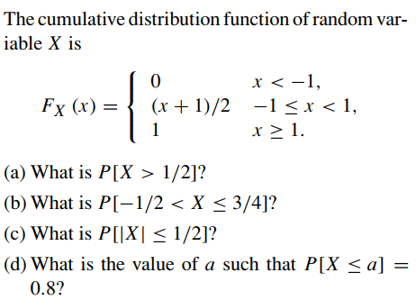
Problem - 1
Ans: 1/4
Ans: 5/8
Ans: 1/2
Ans: a=0.6

Slide 2
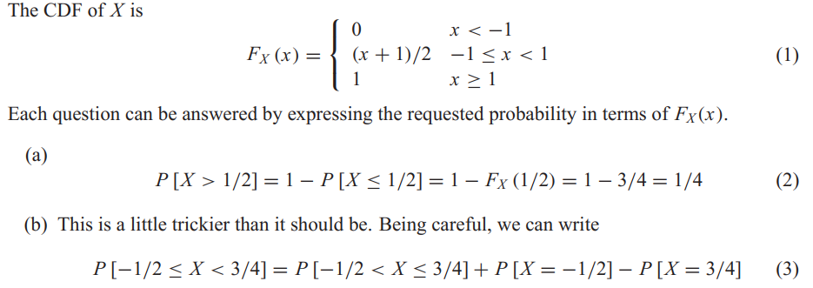
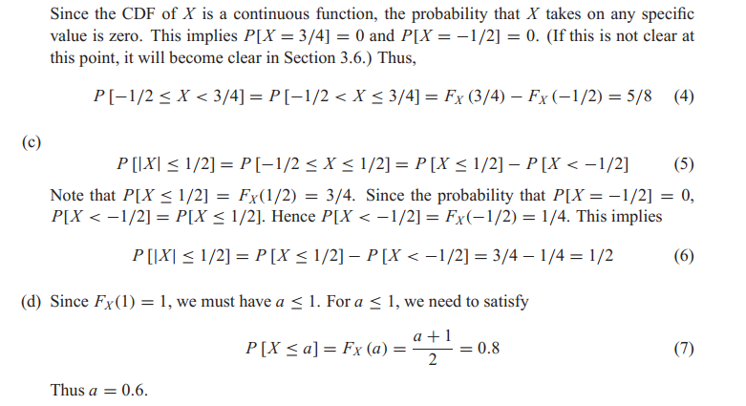
Solution

Slide 3
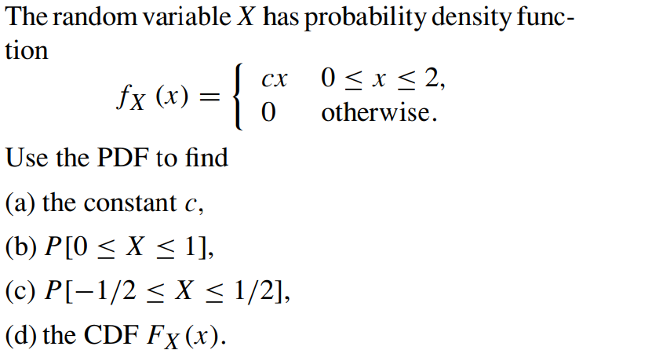
Problem - 2
Ans: 1/2
Ans: 1/4
Ans: 1/16

Slide 4
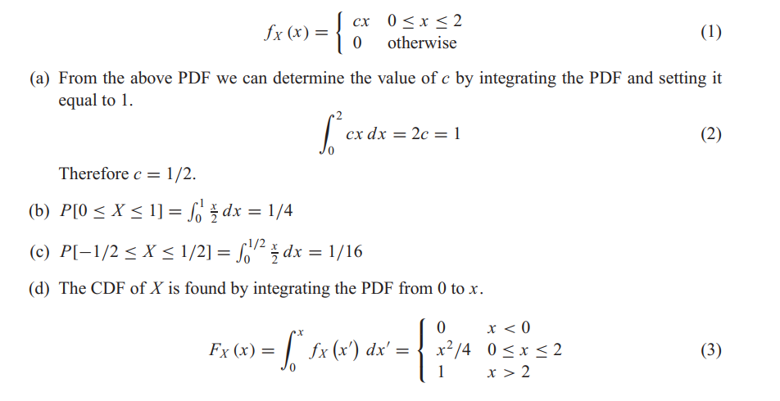
Solution

Slide 5
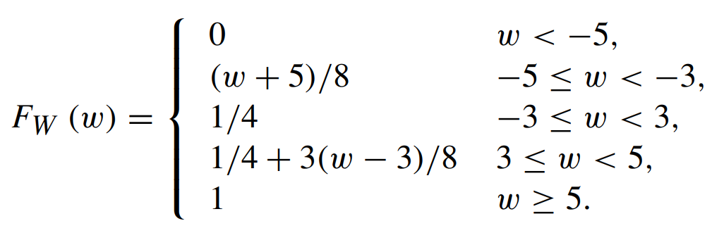

Find the PDF $f_{W} (w)$of the random variable W
Problem - 3

Slide 6
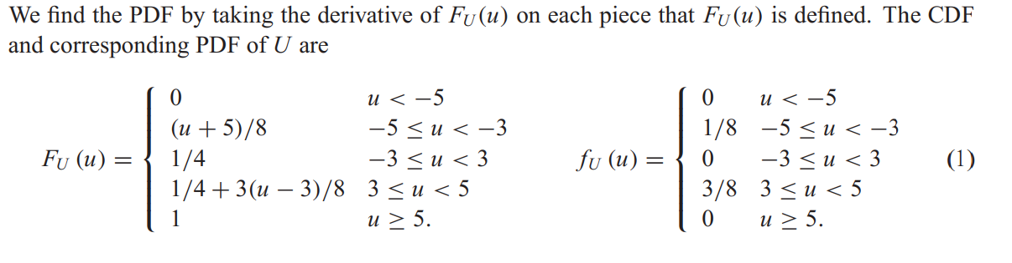
Solution

Slide 7
The peak temperature T , as measured in degrees Fahrenheit, on a July day in New Jersey is the Gaussian (85, 10) random variable.
What is P[T > 100], P[T < 60], and P[70 ≤ T ≤ 100]?
Problem - 4

Slide 8
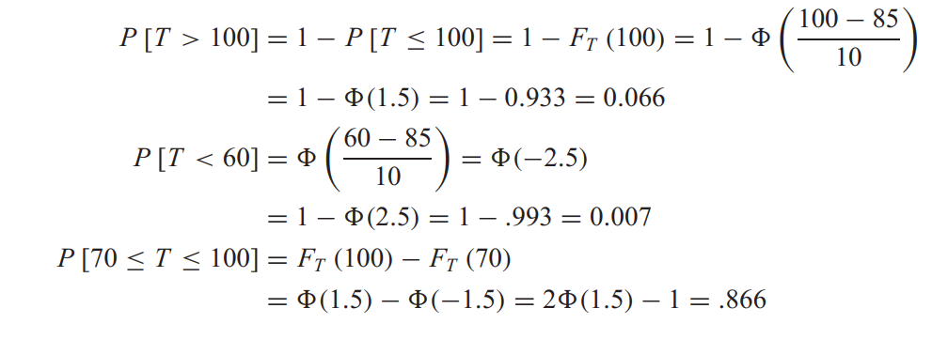
Solution

Slide 9
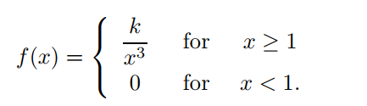
The lifetime, in years, of some electronic component is a continuous random variable with the pdf
Problem - 5
Find k, F (x), and compute the probability for the lifetime to exceed 5 years.

Slide 10
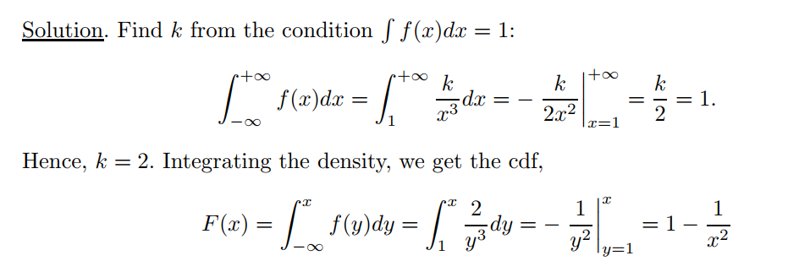
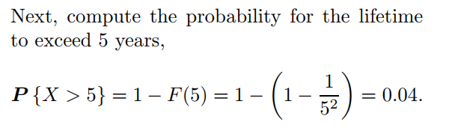
Solution

Slide 11
Jobs are sent to a printer at an average rate of 3 jobs per hour.
(a) What is the expected time between jobs?
(b) What is the probability that the next job is sent within 5 minutes?
Problem - 6

Slide 12
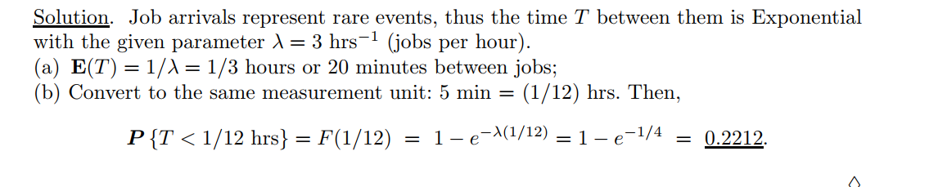
Solution

Slide 13
Suppose that the average household income in some country is 900 coins, and the standard deviation is 200 coins.
Assuming the Normal distribution of incomes, compute the proportion of “the middle class,” whose income is between 600 and 1200 coins.
Problem - 7

Slide 14
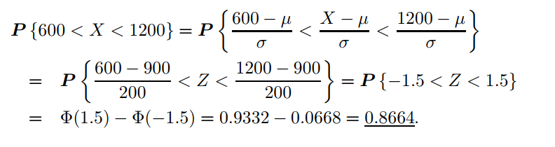
Solution

Slide 15
Suppose it has been observed that, on average, 180 cars per hour pass a specified point on a particular road in the morning rush hour.
Due to impending roadworks it is estimated that congestion will occur closer to the city centre if more than 5 cars pass the point in any one minute. What is the probability of congestion occurring?
Problem - 8

Slide 16
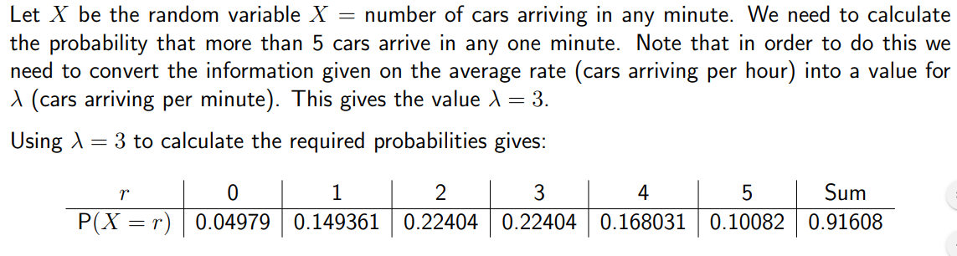
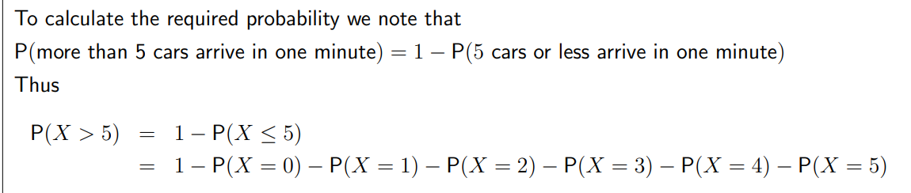
Solution

Slide 17
Problem - 9
A Council is considering whether to base a recovery vehicle on a stretch of road to help clear incidents as quickly as possible. The road concerned carries over 5000 vehicles during the peak rush hour period. Records show that, on average, the number of incidents during the morning rush hour is 5.
The Council won’t base a vehicle on the road if the probability of having more than 5 incidents in any one morning is less than 30%. Based on this information should the Council provide a vehicle?

Slide 18
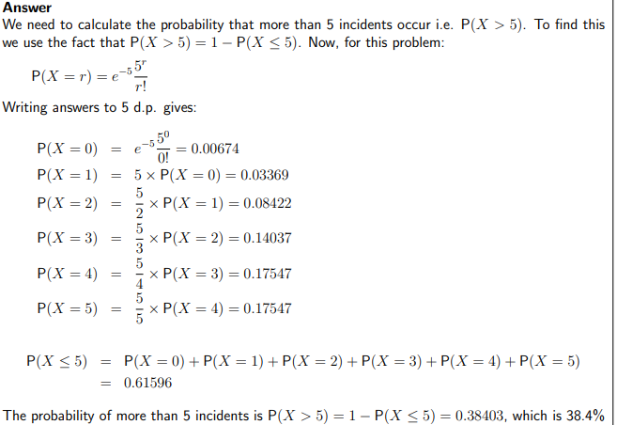
Solution
So the Council should provide a vehicle.

